Slide 1
Uniprocessor Scheduling
Multiprocessor Scheduling
Real-time Scheduling
Chapters 9 & 10
Last Updated 3/26/2018 1:21 PM

Slide 2
Scheduling Ready Processes for Execution
An OS manages many processes each of which require access to limited system resources including processor time.
Scheduling is selecting ready processes in a manner that optimizes scheduling criteria such as response time, throughput, etc.
  Different system types will optimize one aspect over the others.
For example, the difference between scheduling criteria for an Interactive PC, HTTP Web Server, or Big-Data Processing.

Slide 3
Scheduling Criteria
Turnaround Time: The time interval between when a process is started and when it is completed.
  Includes time spent running, ready, blocked, and suspended.
  An important criteria for processing systems too!
Throughput: The number of processes executed to completion over some time period.
  A measure of how much work the system is performing.
  Important in batch processing but not for maintaining services.

Slide 4
Scheduling Criteria
Processor Utilization: The percentage of time the processor spends executing any user process.
  Vs. the time spent idle or maintaining the operating system.
Processor Burst Time: The average amount of time a process spends executing before blocking.
  How much of the process’s scheduling quantum is used.
  For example, blocking for a I/O operation or other syscall.
Fairness: All processes of equal priority should be given equal access to system resources i.e. no starvation.
Enforcing Scheduling Priorities: Processes of higher priority should be scheduled ahead of lower priority processes.

Slide 5
Scheduling Criteria Specific for
Interactive Systems
Response Time: The time interval between when a event occurs (mouse click) and the user sees a response.
Predictability: Producing consistent response times over time.
Notes:
RT OS: Producing a response to a signal / event within a bounded upper limit i.e. producing a response within 5 ms of the event.

Slide 6
Four Types of OS Scheduling
Long-term Scheduling: The decision to accept a new process for execution.
  Not relevant to modern PC and Server OS and not covered in this course.
Medium-term Scheduling:
  The selection of which processes to make ‘ready’ and which to suspend (keep from executing).
  Also not relevant to modern PC and Server OS.
Short-term Scheduling: The selection of which process to execute from the ready queue.
Notes:
Note: The decision of the M-T scheduler to keep a process from a ready state causes the page replacement policy to remove the unexecuting process’s pages from memory (frames).

Slide 7
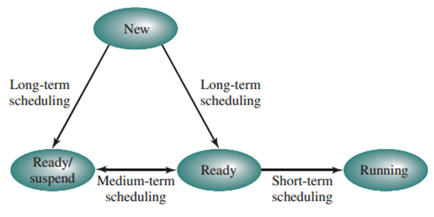

Scheduling State Transitions

Slide 8
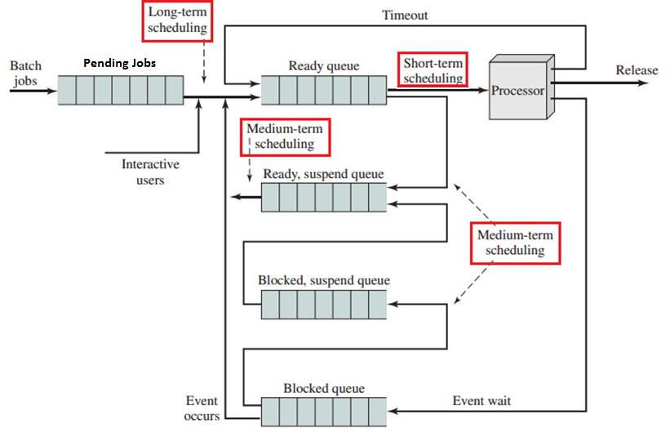
Scheduling Queues

Slide 9
Medium-Term Scheduling
Medium Term Scheduling make decisions concerning which resident process to suspend and resume
  To free memory and other resources for remaining processes.
  Recall, a suspended process will have its pages removed from memory (frames) by the VM Page Replacement Policy.
MT scheduling implements the OS Load Control Policy described in the section on Virtual Memory.
  Attempts to optimize system performance i.e. response time, processor utilization, or whatever is important to the system.
  Minimize page faults, reduce thrashing, increase device utilization, etc. by freeing the resources held by selected processes.
Notes:
For example, if overall process images are growing with a corresponding increase in the system’s page fault rate, the M-T schedule can suspend the execution of some of the processes freeing their frames for the remaining process usage.

Slide 10
Short-term Scheduling
Short-Term scheduling decides which of the ready processes to execute (run).
  Also called the Dispatcher.
The Dispatcher is activated when the currently executing processes times out, becomes blocked, or exits.
  Timer Interrupt (time-out)
  A process makes a blocking system call.

Slide 11
Conflicting Scheduling Criteria
Optimizing for Throughput or Response Time can be at odds.
Optimizing for Throughput requires keeping as many active processes resident as possible.
  Forces inactive pages out of the memory to allow more processes into the system.
  The more active processes the greater the chance one will be runnable.
Optimizing for Response Time requires keeping an inactive pages resident even if they are not currently in a working set.
  When an interactive process is paged-out, the user will experience a hang in the system’s response as its pages are made resident.

Slide 12
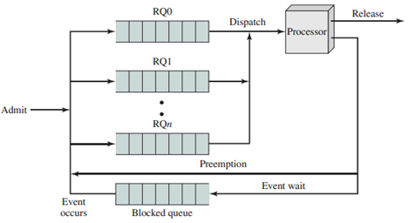
Scheduling Priorities
One of a process’s attributes is it’s priority.
Priority defines the preference the dispatcher gives to scheduling a process.
  The dispatcher will give preference to scheduling processes with high-priorities over lower-priorities.
Strict adherence to priority
scheduling can lead to
starvation of low-priority
processes.
Notes:
IN this example the dispatcher will pull jobs out of the RQ0 queue, before servicing the RQ1 queue, before the RQ2 queue, etc.
Note that strict adherence to this scheduling policy can easily starve processes in low priority queues.

Slide 13
Fairness in Process Scheduling
When designing a scheduling policy we need to consider the starvation of processes based on it’s execution profile.
  Does the scheduling policy give unfair preference to processes with certain execution characteristics?
Long-running vs short-running processes.
  Some scheduling policies will favor the scheduling of long-running processes over short-running processes (or visa versa).
I/O-bound vs compute-bound processes.
  Some scheduling policies will favor compute-bound processes over I/O-bound processes (or visa versa).
Notes:
Recall that an I/O bound process spends much of its time in a blocked state because it repeatedly makes blocking I/O syscalls.

Slide 14
Short-Term Scheduling Policies
This pages describe several short-term scheduling policies.
Each policy has one or more selection criteria used to select the next process to schedule from the set of ready processes.
  Process Priority
  Execution Characteristics including…
    w – The time spent waiting to be scheduled.
    e – The time spent executing.
    s – Service time i.e. the total time the process is expected to need to complete¹.
  Resource Requirements i.e. an I/O-bound vs a compute-bound process.
Notes:
1. Expected implies the OS scheduler ‘knows’ how long the processes is expected to execute. This is difficult (impossible) in most circumstances.

Slide 15
Scheduling Metrics
Service Time (T_{s}) is the length of the process’s execution.
Turnaround Time (T_{r}) is the time the process takes to completed i.e. from arrival to completion.
  Includes time spent waiting to be scheduled for execution.
T_{r} /T_{s} is ratio of the actual-time / minimum-time.
  The delay the process experienced before completing.
T_{r} /T_{s} is a Measure of Fairness.
  The larger the ratio, the more time the process has spent waiting to be executed.
A smaller T_{r} /T_{s} ratio value is considered “more fair”.

Slide 16
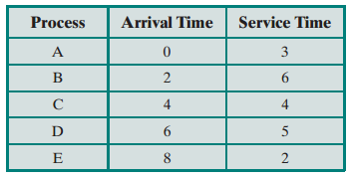
Example Processes
The following short-term scheduling policies are illustrated using this set of processes.
Note that we simplify the discussion by assuming that processes are not blocked during the execution of I/O calls.
Notes:
Both D & E have a turn-around time of 12 but E is perceived as less fair because is service time is much shorter.

Slide 17
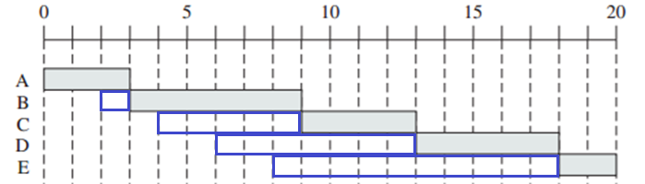
Non-Preemptive First-Come First-Served (NP FCFS)
Processes are scheduled from a FIFO queue.
NP FIFO is non-preemptive i.e. processes run to completion.
  The OS does not interrupt a process’s execution with timers.
  Processes execute until finished (do not block during I/O calls).
Notes:
Considering not timers or blocking this is not a realistic example but is provided to compare to other scheduling policies.

Slide 18
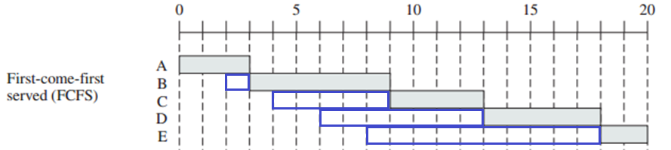
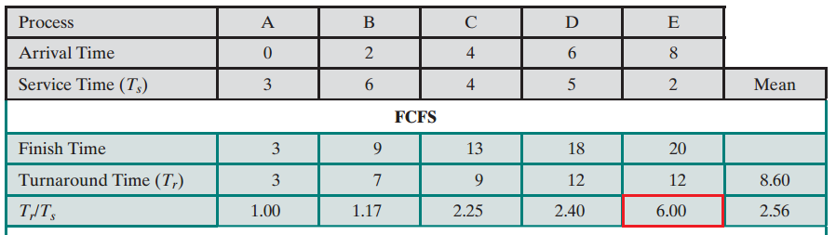
Notes:
One of the issues with this example is that the long-running processes are not blocking for I/O which would provide the opportunity for other processes to execute.

Slide 19
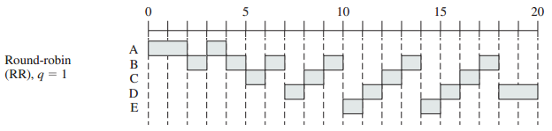
Preemptive Round Robin (RR)
The dispatcher interrupts (preempts) a process’s execution.
  A process runs until interrupted by the OS timer.
Ready processes are maintained in a FIFO.
  Processes are scheduled from the queue’s head.
  New, timed-out, and resumed processes are placed at the tail.

Slide 20
Round-Robin Scheduling
The scheduler assigns a scheduling quantum.
  The amount of time a process is allowed to run before preempted by the timer interrupt.
  The length of a quantum is defined by the timer’s duration.
A compute-bound process will tend to execute for its entire quantum.
An I/O bound process will tend to not use its entire quantum and so will be unfairly scheduled by RR schedulers.
Virtual Round-Robin more fairly schedules I/O processes
  See Text and Assessment Question
Notes:
Virtual RR immediately re-schedules a returning-from-blocked process after the blocking operations finishes so as to finish the quantum that was interrupted by the blocking syscall.

Slide 21
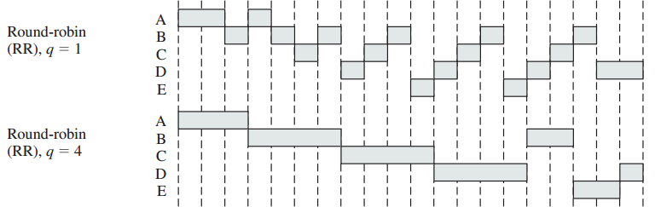
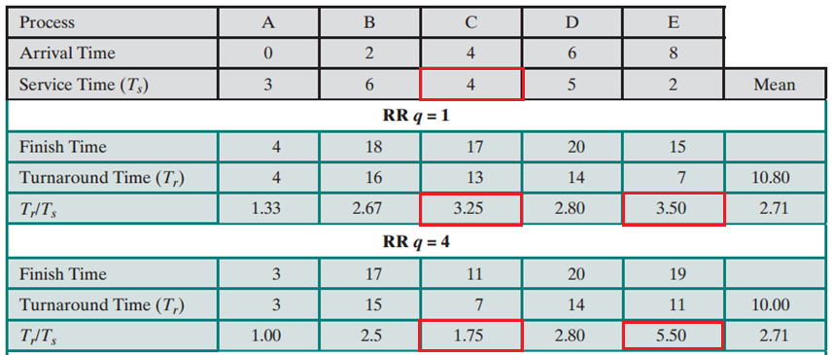

Slide 22
Preemptive Feedback Scheduling
One measure of fairness in batch processing is to given preference to short running processes over long running processes.
  A user that submits a small job should expect to receive their results faster than a large, long-running job.
Feedback scheduling uses multiple priorities to give preference to the most recently created processes.
Or, the longer the process runs, the lower its scheduling priority.

Slide 23
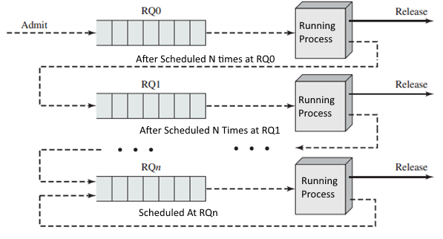
All process start at the highest scheduling priority.
After M timeouts, a process is demoted to a lower priority.
This demotion is repeated N times until the longest lived process are demoted to the lowest scheduling priority.
In this example, each priority is held in its own queue.

Slide 24
Feedback can Starve Long-lived Process
If many short-lived processes enter the system, long-lived processes in their low priority queues can be starved.
One solution is to increase the Time-Slice (TS) given to low-priority / long-lived process.
  Process in RQ0 executes for 1 TS before timing out.
  Process in RQ1 executes for 2 TS before timing out.
  Process in RQn executes for N TS before timing out.
So while low-priority processes are not scheduled as often, when they are scheduled, low-priority processes execute longer than high-priority process.

Slide 25
Tuning the Scheduling Quantum
An important Scheduling Tuning Parameter is the quantum’s duration (q) i.e. the duration of a process’s time-slice.
  A long duration will hurt throughput by favoring compute-bound processes. Virtual Round-Robin Scheduling helps here.
  A short duration will waste processor resources on increased OS dispatcher processing and the overhead of context switching.
Notes:
Virtual Round-Robin is presented in the text.

Slide 26
Multiprocessor and Real-time Scheduling
Chapter 10

Slide 27
Multiprocessor Scheduling Design Issues
This section concerns scheduling on multi-core SMP processors
Assignment of Processes to Processors
  Are processes statically assigned to the same processor throughout its life OR are processes dynamically moved from one processor to another?

Slide 28
Process to Processor Assignment
Static Assignment: The system permanently assigns a new process to a specific processor.
  Processes / threads are assigned to a processor for the lifetime of their execution.
  The scheduler balances the load of M processes across N processors.
Dynamic Assignment: Assign ready threads to the next available processor from a pool of identical processors.
  Symmetric Multiprocessors e.g. multi-core microprocessors.
  For example, threads can be assigned to a processor from a single common ready queue.

Slide 29
Static Assignment of Process To Processors
Processes are dispatched from a Per-Processor Ready Queue
Notes:
In this example, a process is assigned to a processor when it is created.

Slide 30
Dynamic Assignment of Process To Processors
Multiple Processors are Dispatched from Single Ready Queue
Notes:
Processes are dynamically assigned to processors as part of dispatching. This model has a process moving between processors each time it is scheduled.

Slide 31
Dynamic Assignment
Each processor has its own dispatching thread that shares a thread-safe Ready Process Queue.
  For example, the blocking queue from our second assignment.
The overall processing load is naturally balanced by executing threads on the next available processor.

Slide 32
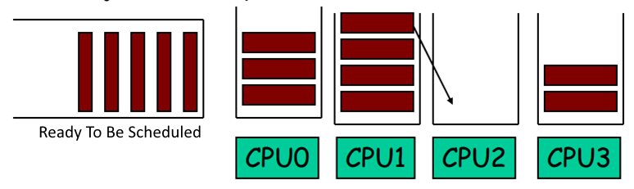
Hybrid Assignment
Ready processes are moved from shared to per-process queues.
A Load Balancer might move processes from large to short queues with the goal of maintaining equal queue lengths for all processors (Linux’s Model).
Notes:
This model is close to Linux’s scheduling algorithm.

Slide 33
Load Balancing
A global scheduler periodically examines processor queues and moves threads between processors so as to balance the Processing Load between all Processors.
  The Load Balancer is an independent service that periodically examines the size / state of the processor’s ready queues.
  See Next Slide

Slide 34
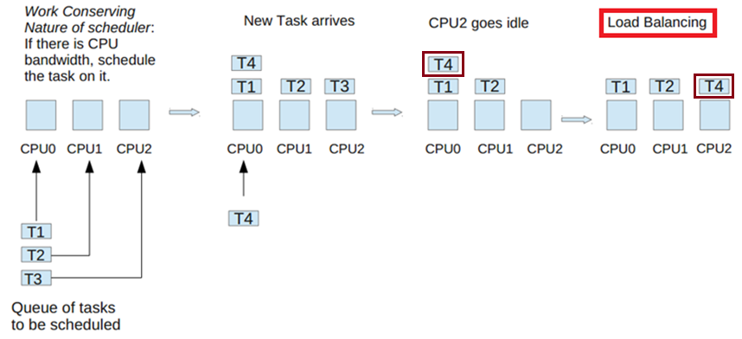
Dynamic Balancing across Three Processors

Slide 35
Thread Scheduling
Threads are light-weight units of execution that share a process’s image address space.
  The application / process creates and coordinates multiple threads.
Two general approaches to thread scheduling and processor assignment:
  Load Sharing
  Gang Scheduling

Slide 36
Thread Scheduling: Load Sharing
Much like Dynamic Assignment, Load Sharing has threads scheduled from a global queue of ready threads.
  The processing load will be evenly distributed across available processors.
Implementation Note: Interrupted processors execute the dispatcher to select the next thread to execute.
  The dispatcher is executed as needed by interrupted or idle processors.

Slide 37
Thread Scheduling: Load Sharing
FCFS: All threads from all processes are placed in a single global ready queue.
  Processors schedule on a single FIFO queue of ready threads regardless of the owning process.
The ready queue can be managed using one of the uniprocessor scheduling algorithms discussed earlier.
  FCFS from Priority Queues using the parent process’s priority as described in previous section.
Notes:
Book suggests that simulations show that FCFS produces the most fair and efficient processor utilization.

Slide 38
Disadvantages of Load Sharing
Threads are unlikely to be re-scheduled on the same processor.
Each processor’s local cache becomes less effective when a thread moves from processor to processor.
  Thread ‘stickiness’ is an advantage of Linux’s ready queue per processor approach.
Notes:
For example, the use of a FIFO of size one or other rendezvous IPC mechanism.

Slide 39
Disadvantages of Load Sharing
If threads from all processes are dispatched for a single FIFO queue, it is unlikely that two or more threads belonging to a single process will scheduled concurrently.
  This is a problem with some multi-threaded applications that requires a high degree of inter-thread coordination / synchronization to execute efficiently i.e. executing threads will be blocked waiting for un-scheduled threads to send a signal, etc.

Slide 40
Disadvantages of Load Sharing
If thread T2 will block waiting for a result from T1, the efficiency of both threads will increase if T1 & T2 are running.
  Keeping cooperating threads running reduces context switches due to blocked threads.

Slide 41
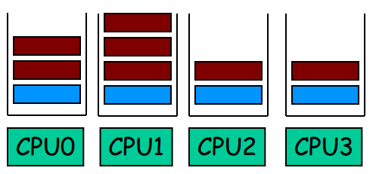
Thread Scheduling: Gang Scheduling
Schedule threads belonging to a the same process (gang) for concurrent execution across N processors.
  Improves the performance of concurrent applications with a high-degree of cooperation / synchronization between threads.
Notes:
Blue threads belong to the same process.

Slide 42
Resource-Aware Processor Assignment
Cooperative Resource (Cache) Sharing
  Because threads belonging to the same process interact through shared memory, their placement on processor cores that share memory cache will enhance overall performance.
  (See next slide)
Resource (Cache) Contention
  If multiple threads are from different processes (i.e. no shared memory), their placement on the same or adjacent cores causes a contention for cache memory shared between processors.
  Each thread will replace the cache contents with their memory reducing the overall effectiveness of cache.
Notes:
There are in fact two different aspects of cache sharing to take into account: Cooperative Resource Sharing and Resource Contention.
With cooperative resource sharing, multiple threads access the same set of main memory locations. Examples are applications that are multithreaded and producer–consumer thread interaction. In both these cases, data brought into a cache by one thread need to be accessed by a cooperating thread. For this case, it is desirable to schedule cooperating threads on adjacent cores.
The other case is when threads, if operating on adjacent cores, compete for cache memory locations. Whatever technique is used for cache replacement, such as least-recently-used (LRU), if more of the cache is dynamically allocated to one thread, the competing thread necessarily has less cache space available and thus suffers performance degradation. The objective of contention-aware scheduling is to allocate threads to cores in such a way as to maximize the effectiveness of the shared cache memory and therefore to minimize the need for off-chip memory accesses. The design of algorithms for this purpose is an area of ongoing research and a subject of some complexity. Accordingly, this area is beyond our scope; see [ZHUR12] for a recent survey.

Slide 43
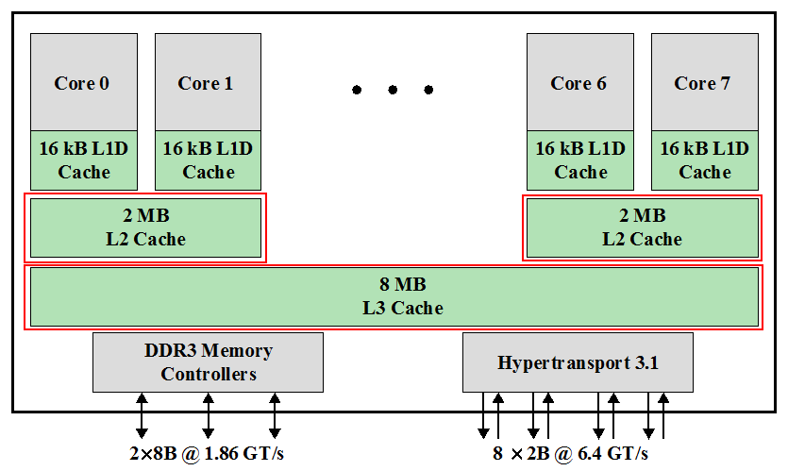
Resource-Aware Thread Placement
Notes:
The most widely used contemporary OSs, such as Windows and Linux, essentially treat scheduling in multicore systems in the same fashion as a multiprocessor system. Such schedulers tend to focus on keeping processors busy by load balancing so that threads ready to run are evenly distributed among the processors. However, this strategy is unlikely to produce the desired performance benefits of the multicore architecture.
As the number of cores per chip increases, a need to minimize access to offchip memory takes precedence over a desire to maximize processor utilization. The traditional, and still principal, means of minimizing off-chip memory access is the use of caches to take advantage of locality. This approach is complicated by some of the cache architectures used on multicore chips, specifically when a cache is shared by some but not all of the cores. A good example is the AMD Bulldozer chip, used in the Operton FX-8000 system, illustrated in Figure 10.3. In this architecture, each core has a dedicated L1 cache; each pair of cores share an L2 cache; and all cores share an L3 cache. Compare this with the Intel Core i7-990X (Figure 1.20), in which both L1 and L2 caches are dedicated to a single core.
When some but not all cores share a cache, the way in which threads are allocated to cores during scheduling has a significant effect on performance. Let us define two cores that share the same L2 cache as adjacent, and otherwise nonadjacent. Thus, cores 0 and 1 in Figure 10.3 are adjacent, but cores 1 and 2 are nonadjacent. Ideally, if two threads are going to share memory resources, they should be assigned to adjacent cores to improve the effects of locality, and if they do not share memory resources they may be assigned to nonadjacent cores to achieve load balance.

Slide 44
  Processor Affinity
Schedule a process / thread to the same processor that it last ran on.
Affinity allows the processor’s cache to remain ‘hot’ because is repeatedly schedule to the same processor.
  The pages accessed by the thread will be present in the processor’s cache.

Slide 45
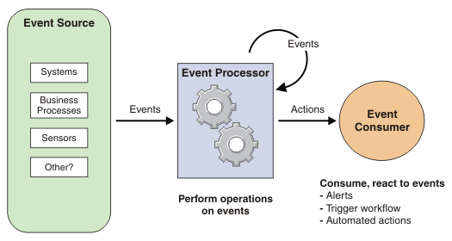
Real-time Operating Systems
A Real-time Application is an application whose successful execution depends not only on the correctness of its results, but also on the amount of time needed to produce a result.
Typically, a real-time applications respond to events from external sources and execute an operation that produces an output / takes an action.
Notes:
Air-bag controllers.
Threat-detection systems in a military aircraft.

Slide 46

RT Example: Airbag Controller
In the event of a collision, the decision of whether to deploy airbags must be made in thousandths of a second.

Slide 47
Real-time Operating System Characteristics
Much like a normal PC or server OS, a RT Operating System provides access to Disk, Network Services, etc.
A Real-Time OS also emphasizes the execution of tasks (instructions) that have been installed by an active process.
Real-Time tasks are executed in response to an incoming trigger-event from an external source.
  Tasks are like threads that are blocked and activated when the trigger event occurs.
Notes:
Normally the handler must execute before the red area (deadline), although requirements may describe both a window of min and max times in which the handler must execute (green area).

Slide 48
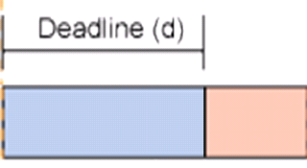
Real-Time Event-Handling Tasks
A RT Event Handling Task is activated in response to a delivered event i.e. a message or interrupt.
Tasks are associated with a deadline that describes the maximum amount of time allowed to execute the task.
  i.e. produce an output / take some action.
  An output produced after the task’s deadline is worthless.

Slide 49
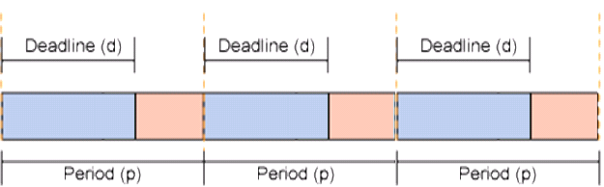
Real-time Periodic Tasks
Periodic Tasks are regularly scheduled tasks that must be started and completed based on deadlines.
  The task is scheduled to periodically execute every N ms.
  And must complete within a deadline.
Notes:
Periodic tasks are NOT event driven, but are schedule by the OS to be executed every N time-units (e.g. ms or us).

Slide 50
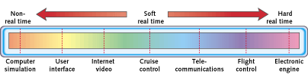
Real-time Operating System Characteristics
Hard real-time tasks are one which a result must be produced before the deadline.
  Failure to meet the deadline results in a systems failure.
Soft real-time is one where the deadlines are suggestions.
  Failure to meet a deadline does not result in a failure.

Slide 51
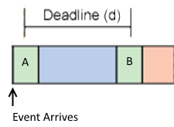
Deterministic Scheduling
Determinism is a quality of the OS that describes…
  The system’s responsiveness i.e. ability to reliably start the execution of tasks in response to events within some minimum delay (A).
  Its ability to complete the task within a given deadline (B).
Notes:
The OS can guarantee the start / completion of a task within some acceptable jitter.

Slide 52
Real-Time Task Characteristics
Ordinary (non-RT) scheduling may require 10’s of ms (milliseconds) to start the task’s execution.
  Hard real-time tasks permit only a few ms or even us (micro) of delay.
Starting the task’s execution can not depend the OS scheduling.
  Task execution is triggered something similar to an interrupt.
  A RT task’s execution cannot be delayed by a process that is currently executing when the event occurs.

Slide 53
Real-Time Task Characteristics
Real-Time Task instructions must be resident in memory.
Starting a RT task’s execution cannot be delayed by paging of non-resident pages and other memory issues.
  The task’s pages must be resident in physical memory frames.
The ability of the task to complete its execution within the deadline depends on the processor’s speed.
  The design of the task must take into account the clock speed (instruction / second) of the hosting processor.
  Task design must look at both the normal and worse-case execution paths.

Slide 54
Real-Time Task Characteristics
The task’s execution can not be delayed by I/O or other blocking operations.
  Executing a database query or other types of blocking I/O is not possible.
  Data structures are maintained or cached in memory.

